Slide 1
Email Security

Slide 2
CONTENTS
THREATS
TYPES OF EMAIL ATTACKS
HOW TO PREVENT THEM?
SECURITY TYPES

Slide 3
INTRODUCTION
Email security refers to the collective measures used to secure the access and content of an email account or service. It allows an individual or organization to protect the overall access to one or more email addresses/accounts.
An email service provider implements email security to secure subscriber email accounts and data from hackers - at rest and in transit.

Slide 4
Threats
Threats to the security of e-mail itself
Loss of confidentiality
E-mails are sent in clear over open networks
E-mails stored on potentially insecure clients and mail servers
Loss of integrity
No integrity protection on e-mails; body can be altered in transit or on mail server
Lack of data origin authentication
Lack of non-repudiation
Lack of notification of receipt

Slide 5
Threats Enabled by E-mail
Disclosure of sensitive information
Exposure of systems to malicious code
Denial-of-Service (DoS)
Unauthorized accesses etc.

Slide 6
What are the Options
Secure the server to client connections (easy thing first)
POP, IMAP over ssh, SSL
https access to webmail
Very easy to configure
Protection against insecure wireless access
Secure the end-to-end email delivery
The PGPs of the world
Still need to get the other party to be PGP aware
Practical in an enterprise intra-network environment

Slide 7
Email based Attacks
Active content attack
Clean up at the server (AV, Defang)
Buffer over-flow attack
Fix the code
Shell script attack
Scan before send to the shell
Trojan Horse Attack
Use “do not automatically use the macro” option
Web bugs (for tracking)
Mangle the image at the mail server

Slide 8
Email SPAM
Cost to exceed $10 billion
SPAM filtering
Content based – required hits
White list
Black list
Defang MIME

Slide 9
How to identify a scam?
Characteristics of scam email
Poor grammar and spelling
The “Reply-to:” or “From:” address is unfamiliar, or is not a ksu.edu or k-state.edu address
Uses unfamiliar or inappropriate terms (like “send your account information to the MAIL CONTROL UNIT”)
It asks for private information like a password or account number
The message contains a link where the displayed address differs from the actual web address
It is unexpected (you weren’t expecting Joe to send you an attachment)
Does not provide explicit contact information (name, address, phone #) for you to verify the communication. Good example is spear phishing scam that tries to steal your eID password is signed “Webmail administrator”

Slide 10
Beware of scams following major news events or natural disasters (e.g., after Hurricane Katrina asking for donations and mimicking a Red Cross web site)
Seasonal scams like special Christmas offers, or IRS scams in the spring during tax season
They take advantage of epidemics or health scares, like H1N1 scam last year
Often pose as legitimate entity – PayPal, banks, FBI, IRS, Wal*Mart, Microsoft, etc.
If unsure, call the company to see if they sent it (we did this with recent email from Manhattan Mercury)
Hackers very good at imitating legitimate email – will use official logos, some links in the email will work properly, but one link is malicious
Many make sensational claims; remember to apply the common sense filter – if it sounds too good to be true, it probably is

Slide 11
HOW TO PREVENT THEM?
Block emails that are not personalized or sent from unrecognized IP address or unrecognized user.
Enter personal information in papers (documents), on phone or via secured links and IPs only.
Never download attachments or open links sent via unknown or unrecognized senders.
Never share personal or financial information like passwords and login IDs with anyone.
Never enter personal data in pop-up screens.
Install firewall, spyware, anti-virus, and spam-spotting software in your computer.
Change your passwords regularly.

Slide 12
Evaluating attachments
Don’t open email attachments you were not expecting
From someone you do not know
From someone you know, but weren’t expecting them to send you a file (infected computers can send malicious emails from the owner of the computer to everyone in their email addressbook)
This is especially true if the content of the email message is brief, vague, and/or unusual

Slide 13
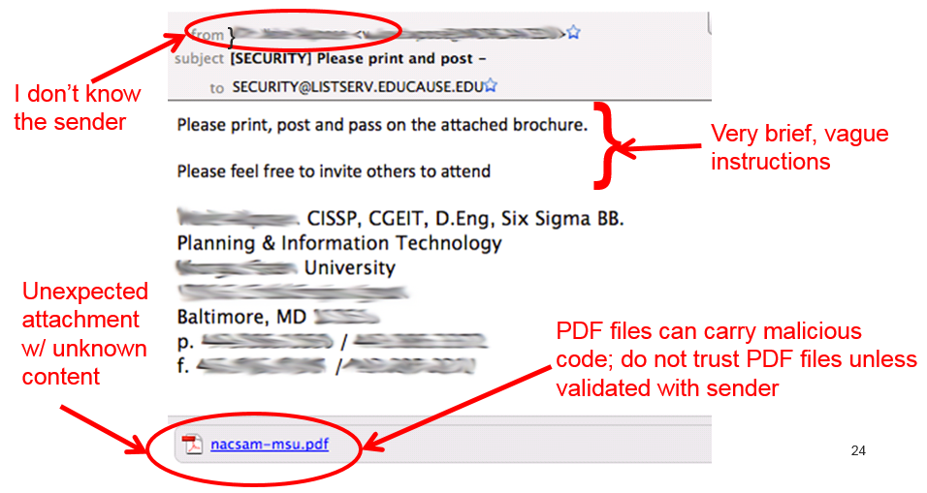
Should I trust this email?

